Slide 1
Small Steps to Becoming an Antiracist Educator:
Focus on Teaching and Learning
Spring 2021
Loyola University Chicago

Slide 2
Outline
The Antiracist Educator
Carla Kupe
Director, Professional Identity Formation Program
Loyola University School of Law
Redesigning Your Course, Step by Step
Mary Byrn
Associate Professor
Marcella Niehoff School of Nursing
Critical Information Literacy
Niamh McGuigan
Head of Research and Learning
University Libraries
Discussion

Slide 3
Small Steps to Becoming an Antiracist Educator:
Focus on Teaching and Learning
Spring 2021
Loyola University Chicago

Slide 4
Outline
The Antiracist Educator
Carla Madeleine Kupe, Esq.
Director, Professional Identity Formation Program
Loyola University School of Law
Redesigning Your Course, Step by Step
Mary Byrn
Associate Professor
Marcella Niehoff School of Nursing
Critical Information Literacy
Niamh McGuigan
Head of Research and Learning
University Libraries
Discussion

Slide 5
Why Does It Matter?

Slide 6
You As An Educator
The educator strives to help each student realize his or her potential as a worthy and effective member of society.
The educator therefore works to stimulate the spirit of inquiry, the acquisition of knowledge and understanding, and the thoughtful formulation of worthy goals.
Source: Code of Ethics, Principle I, National Education Association

Slide 7
You As An Educator
In fulfillment of the obligation to the student, the educator—
3. Shall not deliberately suppress or distort subject matter relevant to the student's progress.
4. Shall make reasonable effort to protect the student from conditions harmful to learning or to health and safety.
5. Shall not intentionally expose the student to embarrassment or disparagement.
6. Shall not on the basis of race, color, creed, sex, national origin, marital status, political or religious beliefs, family, social or cultural background, or sexual orientation, unfairly—
Exclude any student from participation in any program
Deny benefits to any student
Grant any advantage to any student
Source: Code of Ethics, Principle I, National Education Association

Slide 8
You As Faculty At Loyola University Chicago
Loyola School of Law’s Revised Mission is
to educate students to be responsible and compassionate lawyers, judges and law-related leaders in an increasingly diverse and interdependent world;
to prepare graduates who will be ethical advocates for justice and equity, who will lead efforts to dismantle the legal, economic, political, and social structures that generate and sustain racism, and all forms of oppression, and who will advance a rule of law that promotes social justice; and
to contribute to a deeper understanding of law, legal institutions and systems of oppression through a commitment to transformation, intersectionality, and anti-subordination in our teaching, research, scholarship, and public service.

Slide 9
You As An Institutional Ambassador
Whether you are tenured or not, your conduct has an effect on the bottom line and the reputation of Loyola
Your conduct will have an impact on your own reputation in your professional and potentially your personal life

Slide 10
Privilege of Teaching
vs.
Reality of Harm

Slide 11
Balancing Benefit versus Impact
While our profession commits to the free expression of ideas, including those that are controversial or unpopular, as educators we cannot allow or engage in harmful and discriminatory conduct or expression as, besides being illegal in some instances, they may prevent some individuals from participating fully in the life of the academic community in all instances

Slide 12
The UIC/John Marshall Example

Slide 13
Introspection &
Active Awareness

Slide 14
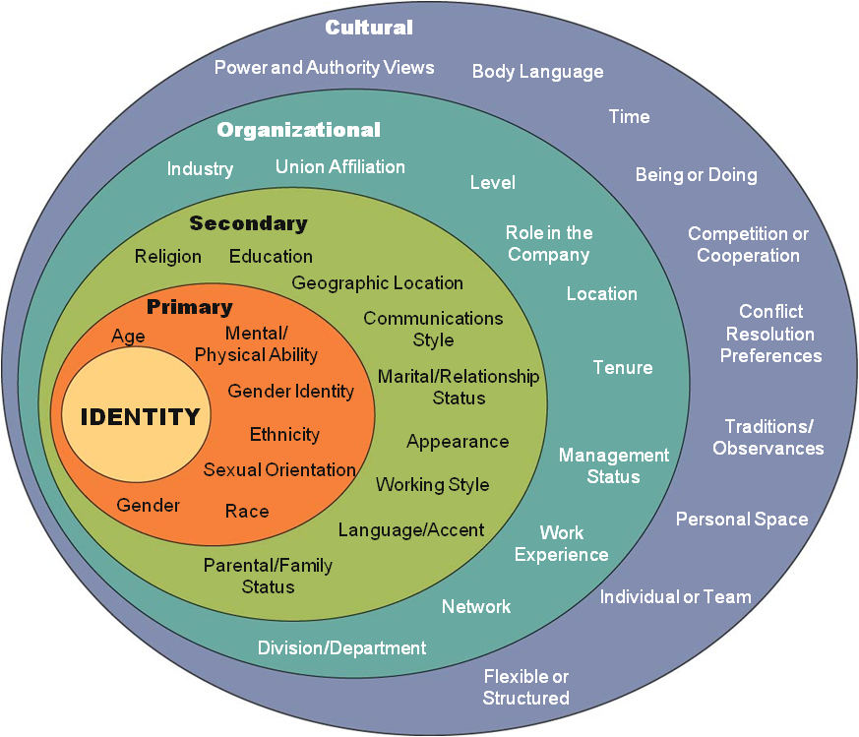
What Makes You “You”?

Slide 15
This Is You
Every human being’s identity is based on the setting and circumstances into which we are born, how we are raised, the norms and beliefs of the communities to which we belong, and the context of where we live, in addition to our own lived experiences
What we believe about ourselves and other people - positive and negative - arises from these intersecting dynamics
As we evolve as adults in our personal and professional lives, being aware of how we think and see others and the world is indispensable for this growth process

Slide 16
This Is You As an Educator
In the setting of being an educator, being mindful partially means being aware that our lived experiences and identities are not “checked at the door” but go with us into the job
Mindfulness and awareness of ourselves and our biases and privilege should be part of our practice
Cognitive biases play a role in our prejudice, and research suggests that mindfulness can help us correct them

Slide 17
This Is You As a Part of A System
As educators we are part of the educational system, a system that was built for the benefit of some but historically and systemically excluded others
From the content of our textbooks to how testing and evaluation methods, we as anti-racist pedagogues must not only carry that reality in us but have to actively address and eliminate those inequities and obstacles in order to center inclusion and equity in our educational environments

Slide 18
Key Take-Aways

Slide 19
Staying Aware and Being Mindful
Our upbringing, lived experiences, and world views, consciously or subconsciously, inform and guide how we see ourselves on the job, how we see and relate to our clients and other parties, as well as the systems within which we practice law
Be humble: we all carry bias in us and we must allow others to hold us accountable or educate us when we engage in harmful speech or conduct
Take ownership, apologize, and commit to growth
Appreciate the difference between intent and impact

Slide 20
Self-Care/Awareness
Self-Reflection
We all have biased beliefs – explore your own
Explore your intersecting identities
Recognize your privilege
Education
Take advantage of what is available around you/at Loyola (panels, events, student organization events, etc.)
Explore and participate in groups on campus or professional associations
Seek additional resources
Do not exclusively seek BIPOC (Black, Indigenous, people of color) friends, family members, students, or colleagues to educate you - take initiative

Slide 21
Self-Care/Awareness
Set Boundaries
Manage contact with people and places that harm you (not to be confused with brave spaces)
Recognize your own dis/comfort in discussing bias or other possibly triggering topics
Engage and disengage in conversations as needed
Find Ways to Speak Up
Assess your comfort level and risk tolerance
Join organizations and advocacy groups
Speak out/up in your classrooms, faculty meetings/committees, public forums, etc.

Slide 22
Mary Byrn, PhD, RN
Associate Professor, Marcella Niehoff School of Nursing
Course: GNUR 207: Concepts of Professional Nursing Practice
Notes:
Put handout in chat: https://docs.google.com/document/d/1DCobz4aUtHTJPjq9IhGgRIkvoVs2BGcdihic37qsSE4/edit?usp=sharing

Slide 23
First Steps
First- attended the Online Reading Group offered by Center for Experiential Learning.
Second- attended multiple sessions of the Anti-Racist Pedagogy Series
This Photo by Unknown Author is licensed under CC BY

Slide 24
Second Step
Read the course description and course outcomes
Met with other faculty teaching course
Took each course outcome and scheduled it in course calendar
This Photo by Unknown Author is licensed under CC BY-SA

Slide 25
Biggest Changes
Moved from primarily lecture method to seminar and discussion style class
Students assigned “pre-class work” every week.
Included reading articles, watching YouTube videos, listening to podcasts, searching the internet
Used breakout rooms
Removed textbook
Used “Immortal Life of Henrietta Lacks” by Rebecca Skloot
Majority of class was student led discussion
Students would select a topic from a list or purpose their own topic
Assign a resource for class to review before class
Evaluate the resource using the CRAPP evaluation
Removed quizzes and exams
Replaced with six reflection assignments
Three on Henrietta Lacks reading and three on personal reflection of topic chosen

Slide 26
Feedback from Students
Completed a mid-semester evaluation as a check in
Smart Eval feedback was very positive
Section 003: Response rate 91%
Average of items greater than 4.0
Section 004: Response rate 84%
Average of items greater than 4.0
Themes from comments:
Students appreciated being able to discuss topics and learn from each other
Students felt the course was engaging
Students felt it was a safe space to share and learn from each other

Slide 27
Changes for Spring Semester
Reduce the number of Lacks reflections and improve the rubric
Increase the amount of grade designated for completion of “pre-class work”
Add inclusive statement to syllabus
This Photo by Unknown Author is licensed under CC BY-SA
Notes:
Respect for Diversity and Importance of Inclusion (from Mary Byrn):
Your experience in this class is very important to me. It is my intent and goal that this learning environment be one where all students and faculty are respected. I hope to present all class materials and activities in a way that is respectful of diversity: gender, sexuality, disability, age, socioeconomic status, ethnicity, race, religion, culture, and others. Students experiences and perspectives are valued. I encourage all students to share experiences and perspectives so we all may learn from each other. I support and intend to create an environment where diverse perspectives are respected and viewed as a strength in the materials learned and discussed in this course. If there are any aspects of this course that result in a barrier to your inclusion or ability to meet course outcomes, please notify me as soon as possible.

Slide 28
Workload and personal reflection
Hard to estimate total amount of time to make changes
Took the most time was finding resources
Course is grading intensive
Based on student feedback, it was worth it
Enjoyed the student led discussions and learning from their resources

Slide 29
Small Steps to Becoming an Antiracist Educator:
Critical Information Literacy
Niamh McGuigan
Head of Research and Learning
University Libraries
Loyola University
Chicago Libraries
Knowledge in your grasp

Slide 30
Some Definitions...
Information literacy
Critical pedagogy
Anti-racist pedagogy
Critical information literacy

Slide 31
Some Definitions...
Information literacy:
“Information literacy is the set of integrated abilities encompassing the reflective discovery of information, the understanding of how information is produced and valued, and the use of information in creating new knowledge and participating ethically in communities of learning.”
Association of College and Research Libraries, 2015
Critical pedagogy:
“Habits of thought, reading, writing, and speaking which go beneath surface meaning, first impressions, dominant myths, official pronouncements, traditional clichés, received wisdom, and mere opinions, to understand the deep meaning, root causes, social context, ideology, and personal consequences of any action, event, object, process, organization, experience, text, subject matter, policy, mass media, or discourse.”
Ira Shor, 1997

Slide 32
Some Definitions...
Anti-racist pedagogy:
“A pedagogical approach that reveals the structural inequalities within U.S. society, while fostering students’ critical analysis skills, as well as their critical self-reflection.”
Columbia University Teaching and Learning Center, 2020
Critical information literacy:
“A focus on the social construction and cultural authority of knowledge; the political economies of knowledge ownership and control; and the development of local communities’ and cultures’ capacities to critique and construct knowledge.”
Allan Luke and Crushla Kapitzke, 1999

Slide 33
Critical Information Literacy and Anti-racist Pedagogy – What’s the connection?
Critical information literacy helps students to be better researchers and writers.
Critical information literacy also provides a pathway for empowering students to question and engage with knowledge sources.
Structural racism and white supremacy are inherent in many aspects of publishing, academia, and libraries.
https://www.sofiayleung.com/thoughts/how-lis-upholds-white-supremacy
Instruction tends to focus on shortcuts for “reliable” and “reputable” sources, without deeper consideration.
Critical information literacy can give students tools and agency to critique the authoritative sources they encounter in their coursework, and develop responsible ways of interacting with information.

Slide 34
Source evaluation is a good place to start
https://libguides.luc.edu/ucwr110/evaluate

Slide 35
Ways to Move Beyond Source Evaluation
Invite students to question and critique course materials through structured discussion and activities.
Call attention to “perverse incentives” for researchers in your discipline.
Consider the role of specialized vocabulary or of “correct” academic writing.
Discuss the role of authoritative sources in your discipline. Why are some sources considered authoritative in everyday life, but not in a works cited list?
Model the process of analyzing websites, online databases, and interfaces when doing research.

Slide 36
Some Activities to Try
News literacy
Who writes a New York Times op-ed, and why?
Authority trivia
Assign groups to find the answer to questions about popular culture, and explain why the source of their answer is authoritative.
Ask them to do same with questions related to your course content, and compare the experiences.
Extended annotated bibliographies
For each source listed, find another source that cites the original source.
What did you learn?
Mapping scholarly networks
List all of the authors cited in a work and gather basic information such as institutional affiliation, gender, educational background, mode of research, etc.
Discuss your findings? Where do you see a lack of diversity? How might that impact the research? Who has been left out of the conversation?
Social life of scholarship
Read a scholarly article, paired with a blog post, podcast, twitter thread, or news or magazine article about the research.
What light do these other modes of communication shed on the original research?

Slide 37
Resources
CORE Method for Source Evaluation
Terri Artemchik, Emily Cukier, Anthony Morgano
https://libguides.luc.edu/ucwr110/evaluate
Critical library pedagogy handbook. Volume 1, Essays and workbook activities
Nicole Pagowsky and Kelly McElroy
https://luc.primo.exlibrisgroup.com/discovery/fulldisplay?docid=alma99213818412902506&context=L&vid=01LUC_INST:01LUC&search_scope=MyInst_and_CI&tab=Everything&lang=en (Loyola affiliation required)
Critical library pedagogy handbook. Volume 1, Essays and workbook activities
Nicole Pagowsky and Kelly McElroy
https://luc.primo.exlibrisgroup.com/discovery/fulldisplay?docid=alma99213818412802506&context=L&vid=01LUC_INST:01LUC&search_scope=MyInst_and_CI&tab=Everything&lang=en (Loyola affiliation required)
Framework for Information Literacy in Higher Education
Association of College and Research Libraries
http://www.ala.org/acrl/standards/ilframework
How LIS Upholds White Supremacy (And What To Do About It)
Sofia Leung, ALA CORE Forum presentation
https://www.sofiayleung.com/thoughts/how-lis-upholds-white-supremacy
Request teaching help from the University Libraries
http://libraries.luc.edu/instruction_request

Slide 38
Thank you!
Contact your presenter, Niamh McGuigan,
with questions and comments.
nmcguigan@luc.edu
Loyola University
Chicago Libraries
Knowledge in your grasp

